Slide 1
Vehicle Servicing Application

Slide 2
Overview
This is a web-based application that facilitates vehicle servicing at home that intends to deliver doorstep service. This is an integrated system that contains both the user component and the admin component.
The Automotive Workshop owner displays their services & cost for the same, manages the slots booked by Customers along with their details.
The Customers/Users can register & login to the application, browse available services depending on their desired time slots, add them to their cart and check-out thereby confirming the service.

Slide 3
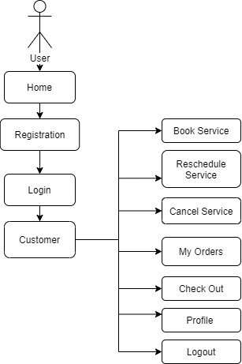
Flow Chart

